Slide 1
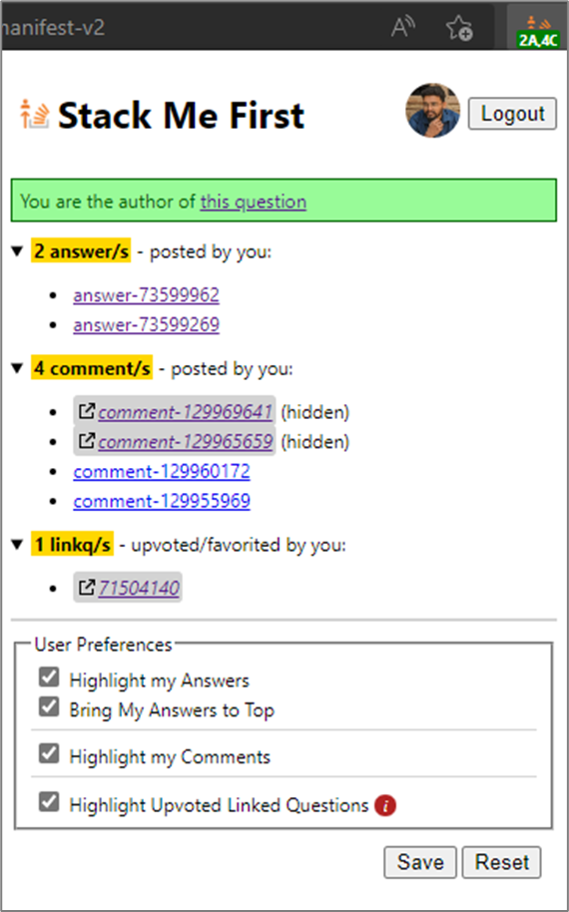
Popup Instructions
Reference Link: https://stackoverflow.com/q/73591695/6908282
1
6
5
3
4
7
2

Slide 2
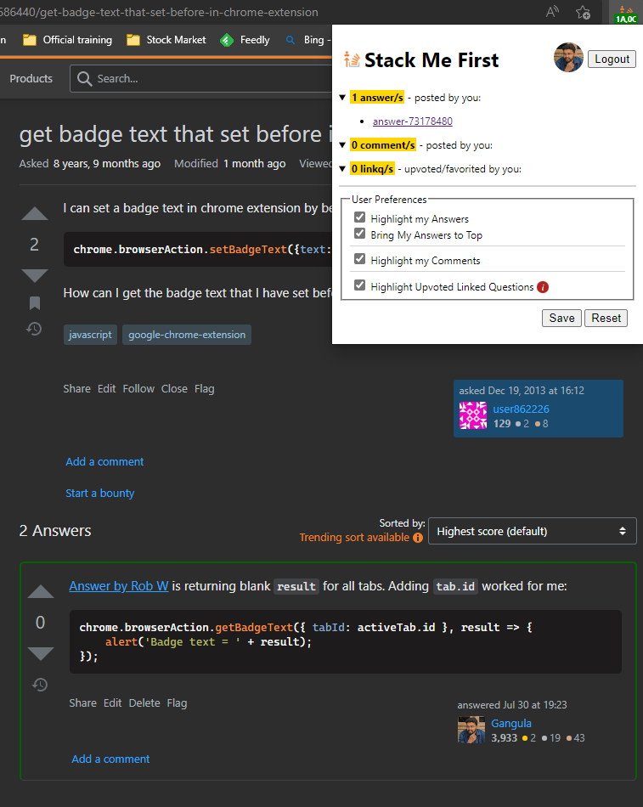
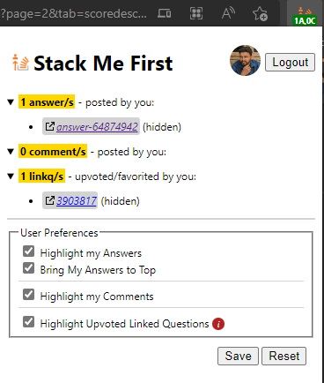
Answers by you
Reference Link: git - How do I update or sync a forked repository on GitHub? - Stack Overflow
https://stackoverflow.com/q/20686440/6908282
https://stackoverflow.com/q/73591695/6908282

Slide 3
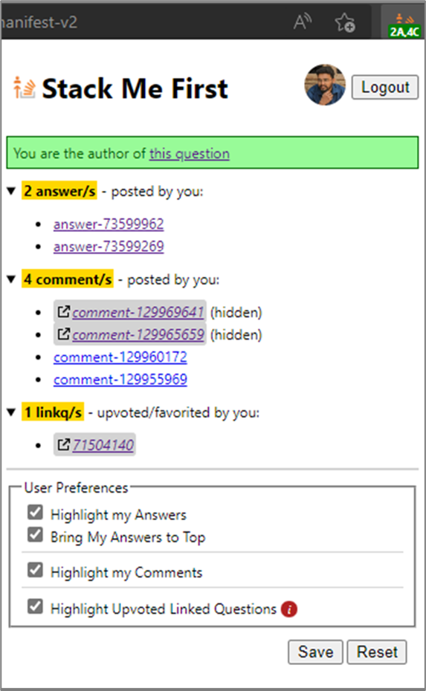
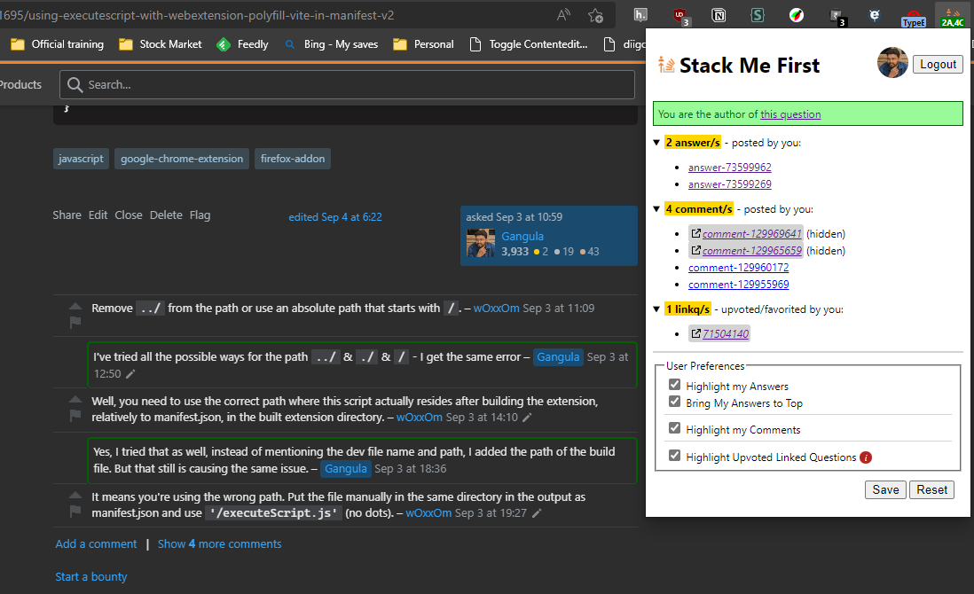
Comments by you
Reference Link: https://stackoverflow.com/q/73591695/6908282

Slide 4
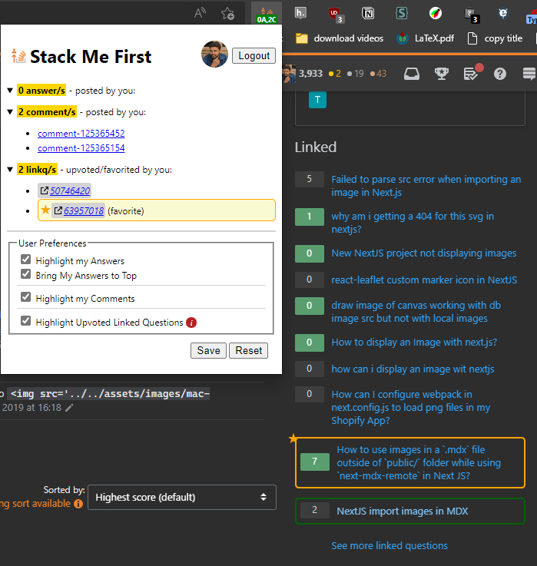
Upvoted/Favorited Linked Questions
Reference Link: https://stackoverflow.com/q/59546370/6908282

Slide 5
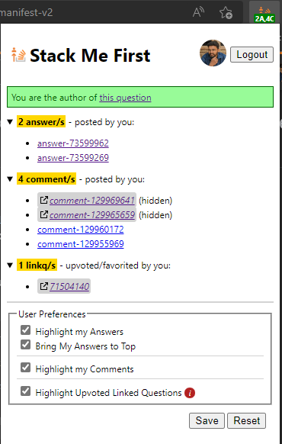
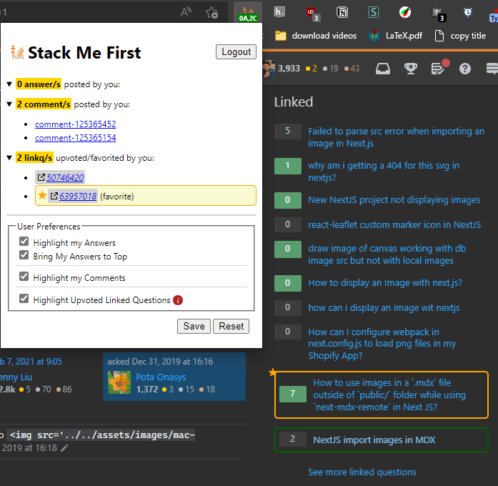
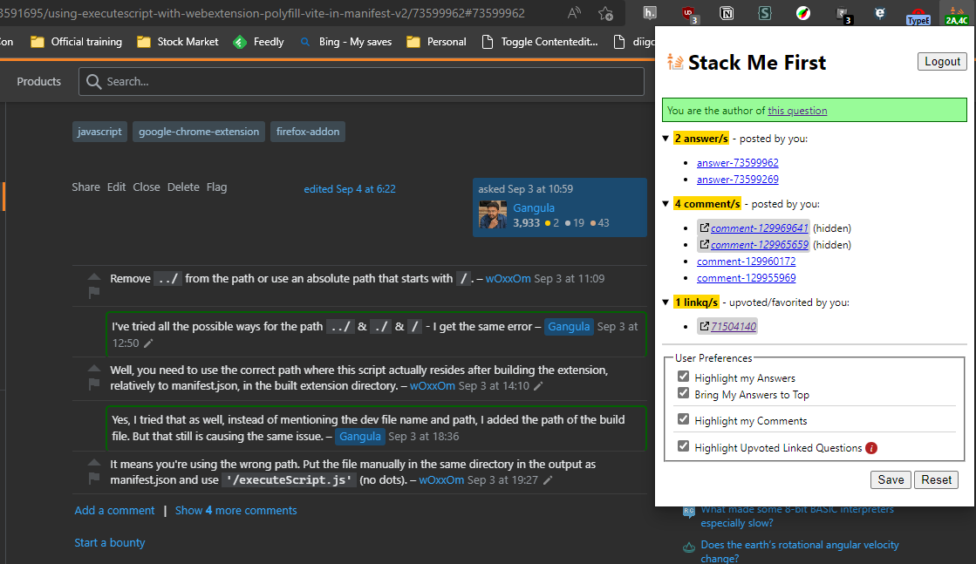
Original Screenshots

